Slide 1

Software Defined Networking
How it has transformed networking and what happens next
Nick McKeown 马格理
Stanford University

Slide 2
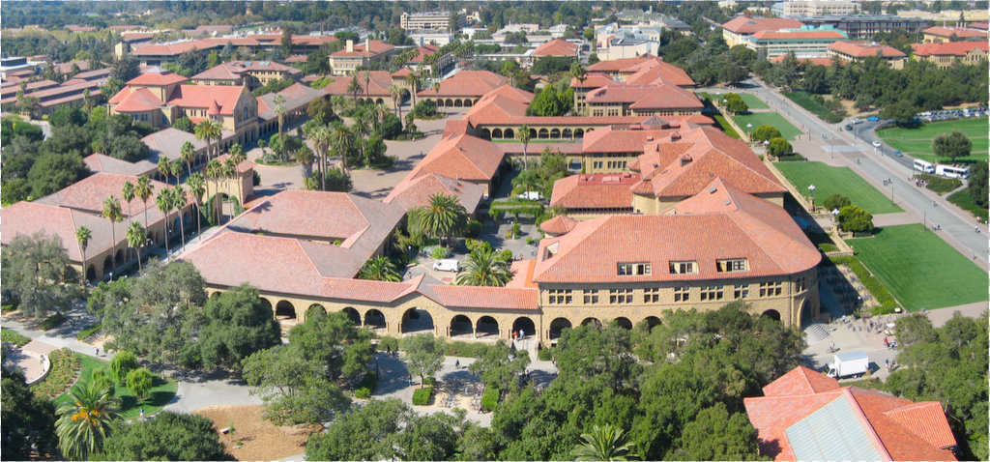
Ethane project:
How difficult is it to write
the control software for our network?
Stanford campus
35,000 users
10,000 new flows/sec
137 network policies
2,000 switches
2,000 switch CPUs
2006

Slide 3




Crazy question: What if software decides whether to accept each flow, and how to route it?
Controllers
Check flow against policy
Pick route
B
A
[Sigcomm ’07, Kyoto]

Slide 4
How many servers do we need for 35,000 users?

Slide 5
Answer:
less than one

Slide 6

If we can define network behavior outside the datapath, then eventually we will.

Slide 7
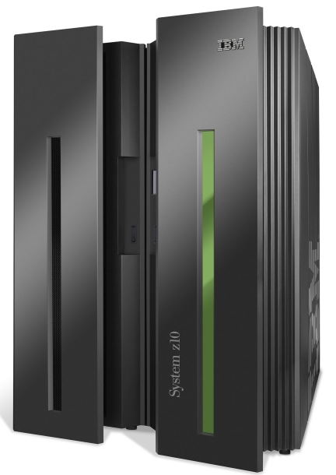
Computer Industry
App
App
App
App
App
App
App
App
App
App
App
Proprietary
Applications
Open Interface
Proprietary
Operating System
Windows
(OS)
Linux
Mac
OS
or
or
Disaggregation
Open Interface
Proprietary
Hardware
Microprocessor

Slide 8
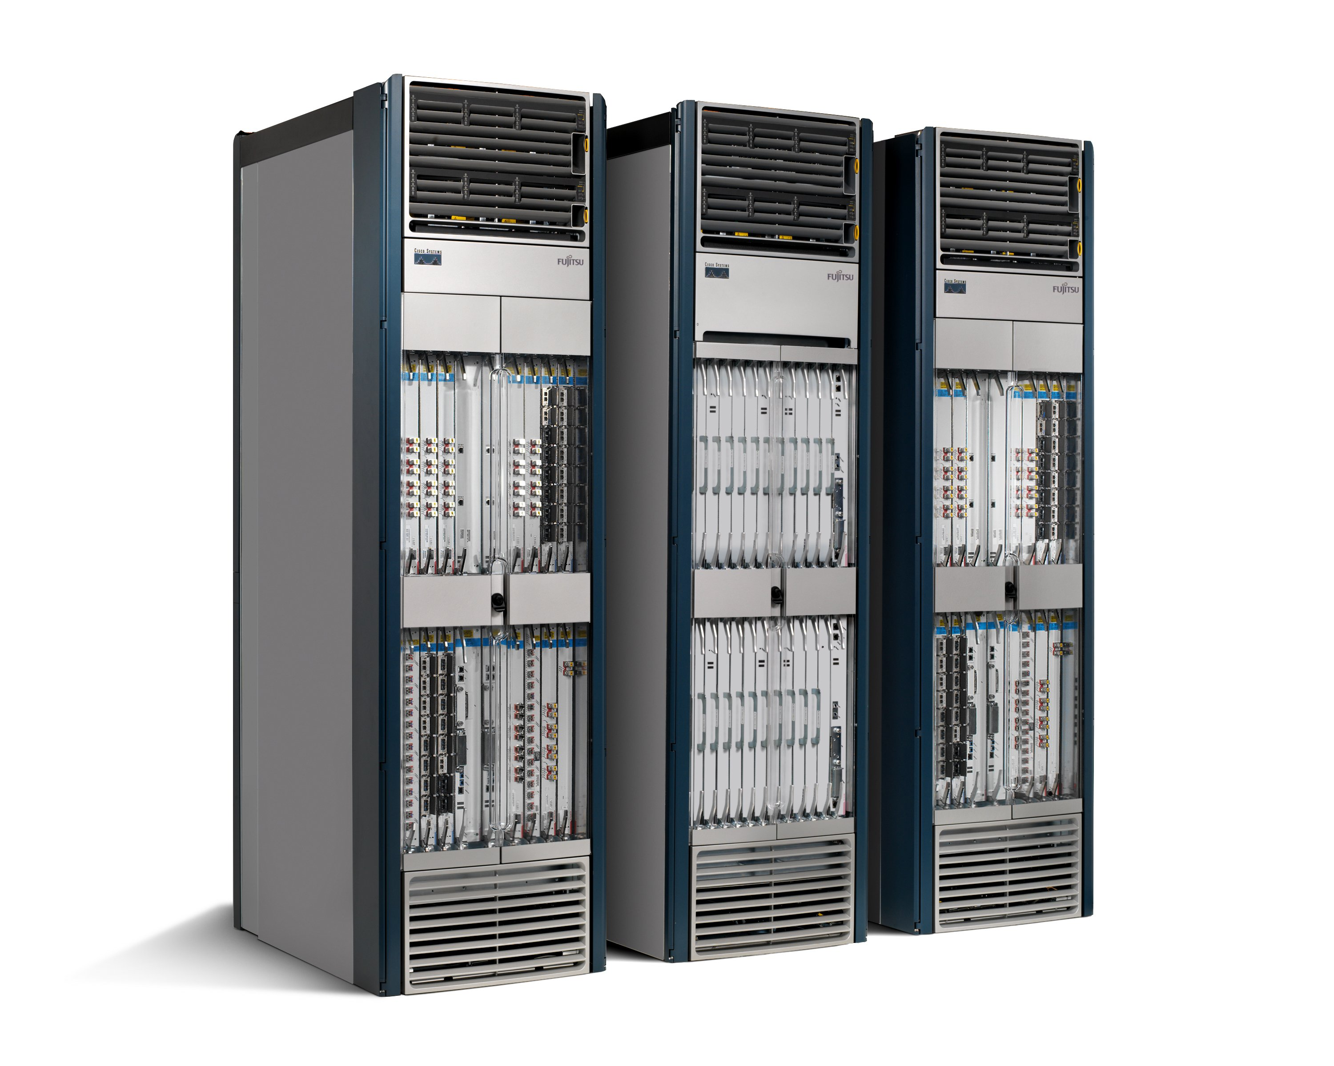
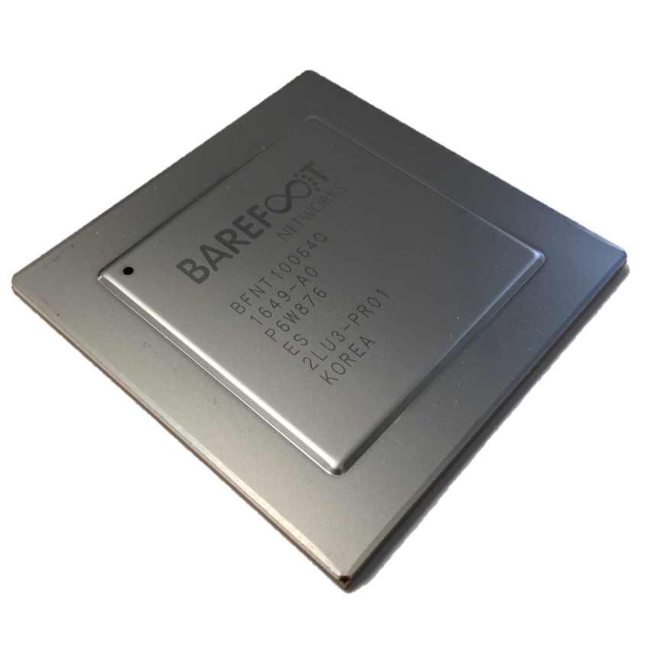
Networking Industry
App
App
App
App
App
App
App
App
App
App
App
Proprietary
Features
Open Interface
NOX
Beacon
ONIX
POX
ONOS
Flood
light
Trema
ODL
Ryu
Control
Plane 1
Control
Plane 2
Proprietary
Operating System
Disaggregation
Open Interface
Merchant
Switch Chips
Proprietary
Hardware

Slide 9
2008
Problem: Network innovation controlled by router vendors.
Consequence: Glacially slow innovation of the Internet.
Solution
Network owners and operators write the software to control their networks.

Slide 10
Software Defined Networks
Part 1: Network owners and operators now define the software to control their network.

Slide 11
SDN was inevitable because…
Rise of Linux.
Rise of whitebox servers and data centers.
Rise of merchant switching silicon.

Slide 12
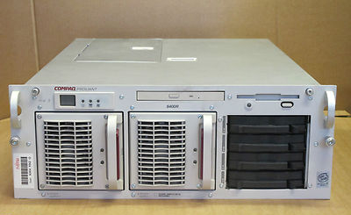

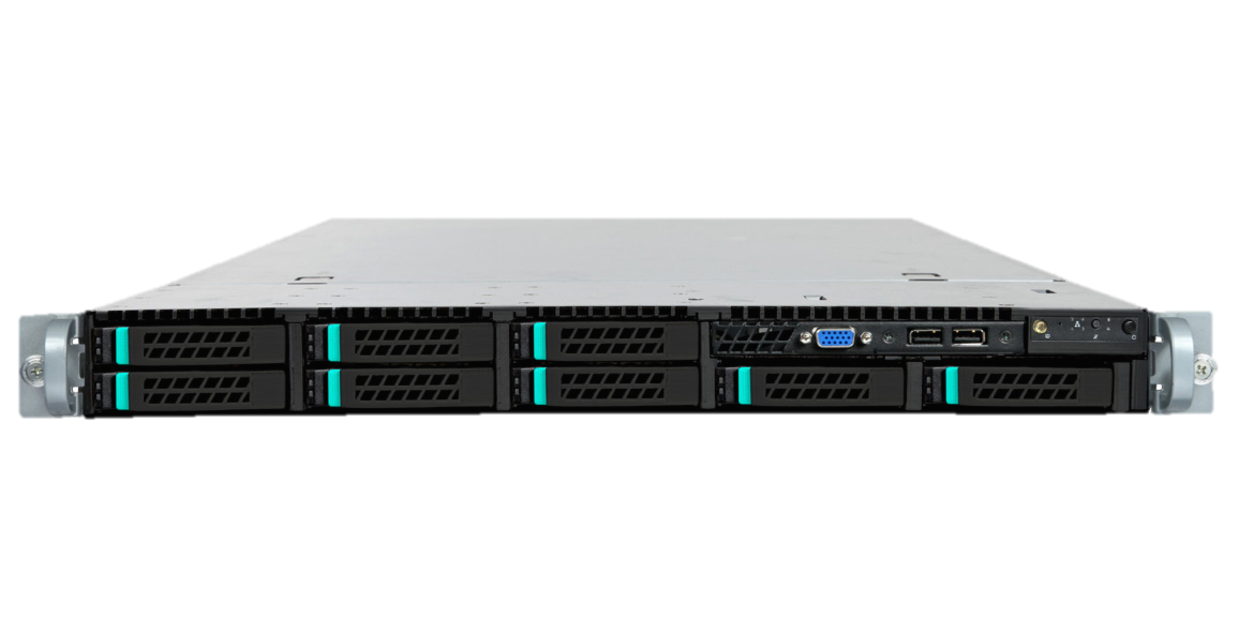
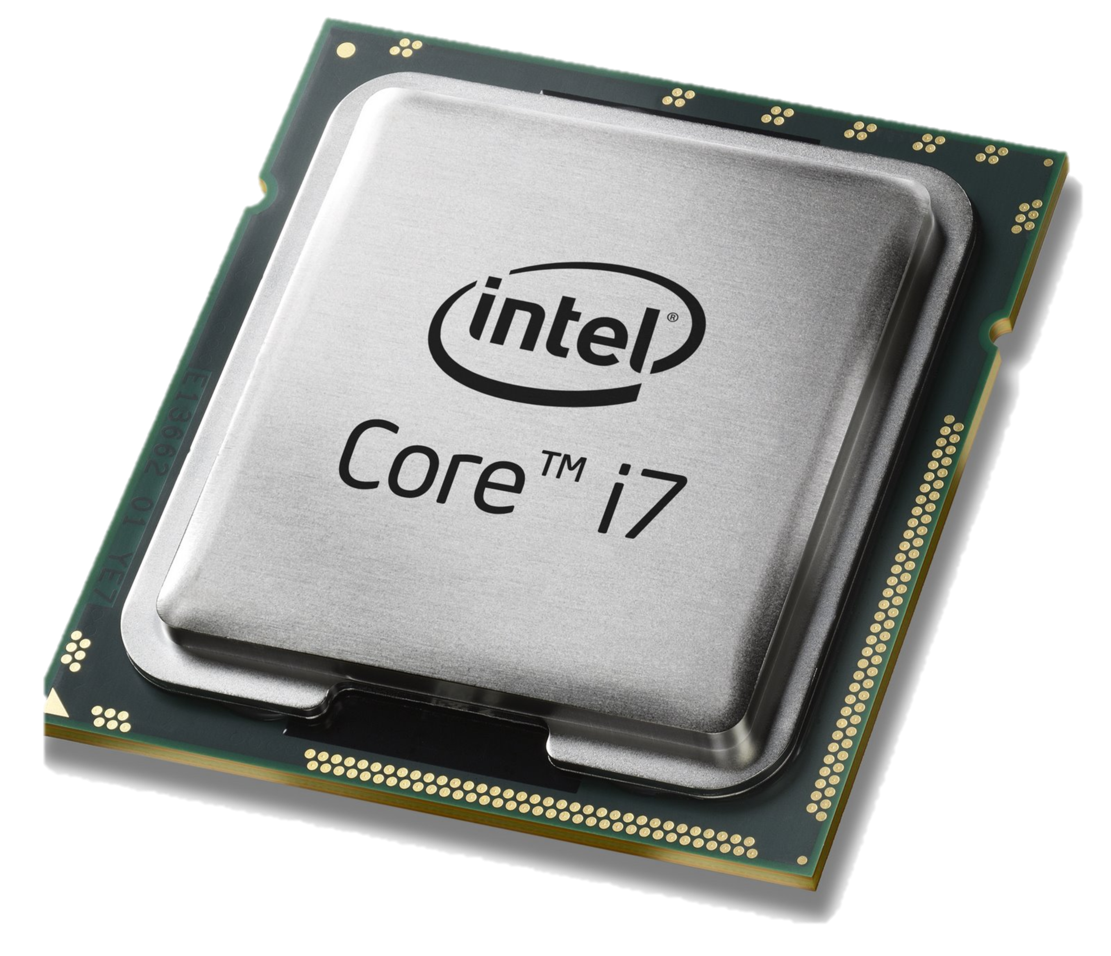
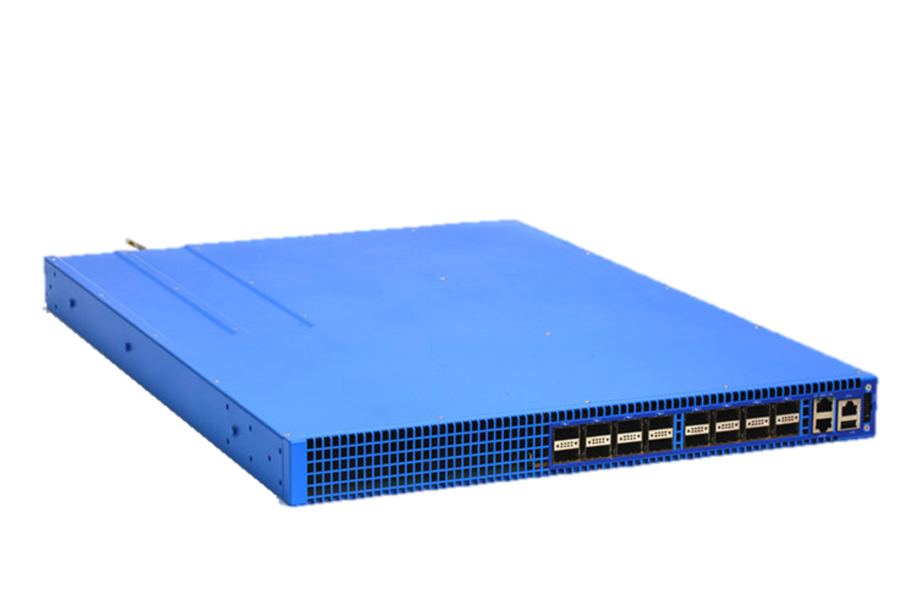
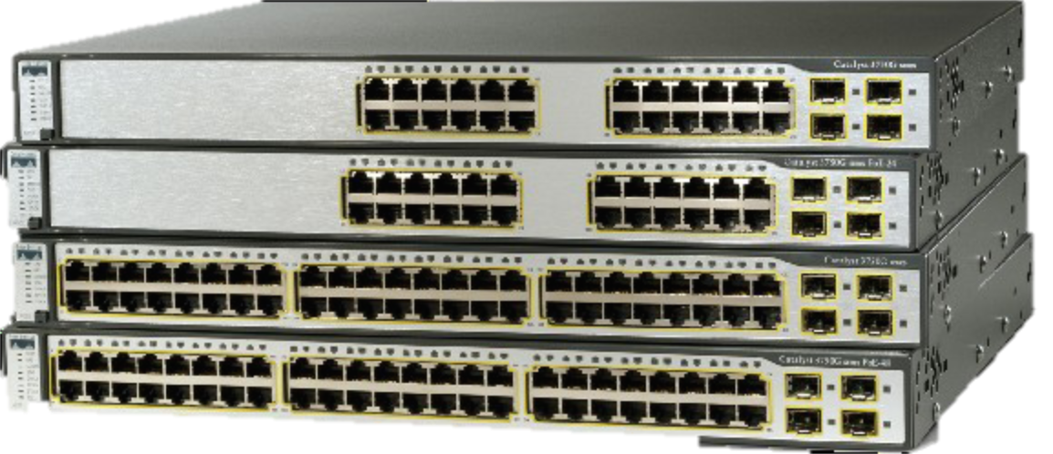
Servers
Applications
Applications
Linux
OS
CPU
x86
Legacy
Whitebox
Network switches
Control Programs
Applications
Linux
OS
CPU + ASIC
x86 + ASIC
Legacy
Whitebox

Slide 13
Example: Big Data Center
Cost
500,000 servers
25,000 switches
$10k per legacy switch = $250M
$2k disaggregated switch = $50M
Savings in 5 data centers = $1Bn
Control
Centralized remote control is easier
“Centralize if you can, distribute if you can’t”
Customized, differentiated network
Home grown traffic engineering
50% utilization → 95% utilization

Slide 14
All networking equipment is disaggregating
5G Gateways and Basestations
Optical and Metro Transport
WiFi Access Points
Residential broadband access
Enterprise network equipment: switches, routers, firewalls
“Software is eating the world (of networking)”

Slide 15
Now I can tailor my network to meet my needs!
I can….
Quickly deploy new protocols.
Monitor precisely what my forwarding plane is doing.
Fold expensive middlebox functions into the network, for free.
Try out beautiful new ideas. Tailor my network to meet my needs.
Differentiate. Now I own my intellectual property.

Slide 16
But wait a minute…
Everything on the last slide is untrue!

Slide 17
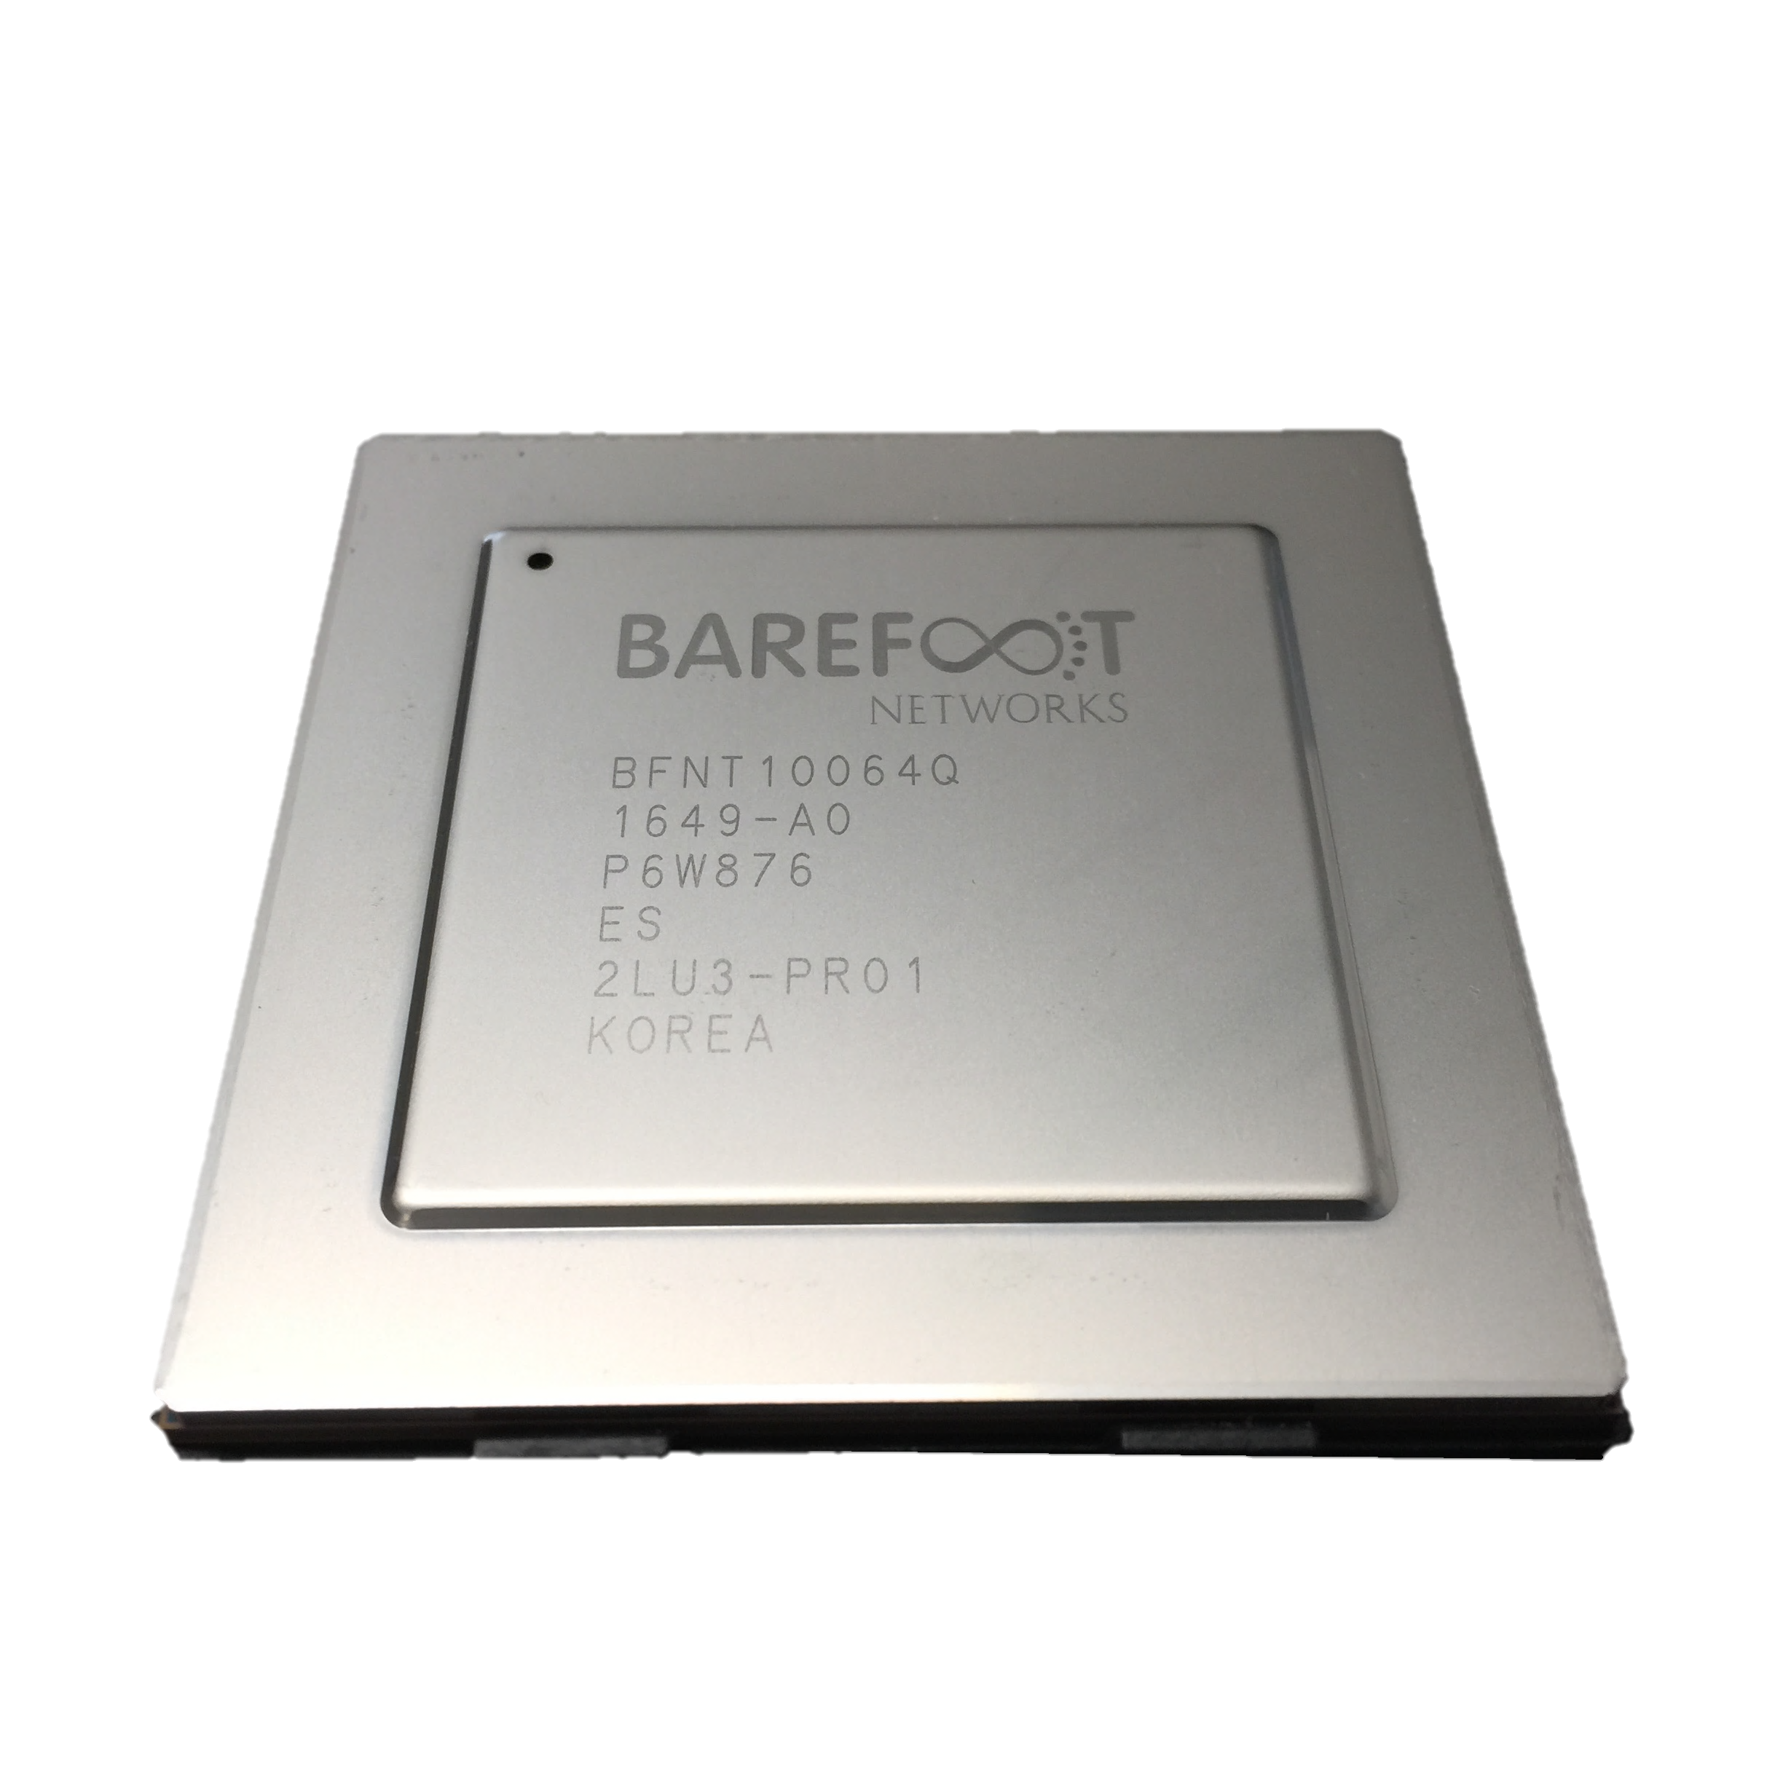
OSPF
BGP
New
etc.
Switch OS
Driver

Slide 18

Feature
Software
Team
Feature
Network Owner
Network Equipment Vendor
Weeks
Feature
ASIC
Team
Years
Years

Slide 19

Network systems are built “bottoms-up”
Switch OS
Driver
“This is how I process packets …”
ASIC
Fixed-function switch

Slide 20
“Programmable switches are 10-100x slower than fixed-function switches. They are more expensive and consume more power.”
Not true any more!
Conventional wisdom in networking

Slide 21
2018
Problem: Network innovation controlled by chip vendors.
Consequence: Glacially slow innovation of the Internet.
Solution
Network system developers write the software
to process packets in their networks.

Slide 22
Software Defined Networks
Part 2: Network system developers take
control of how packets are processed too

Slide 23
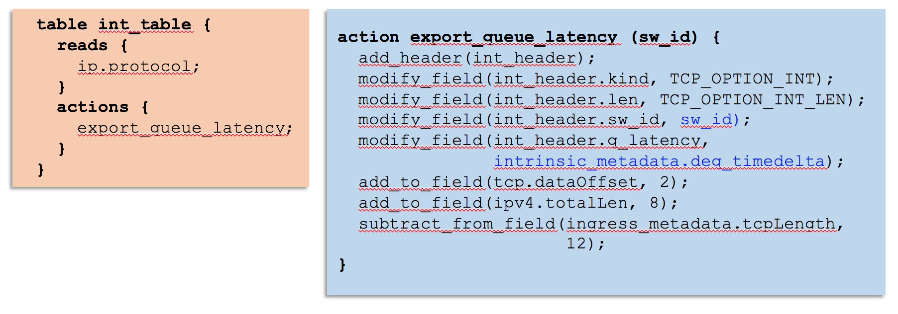
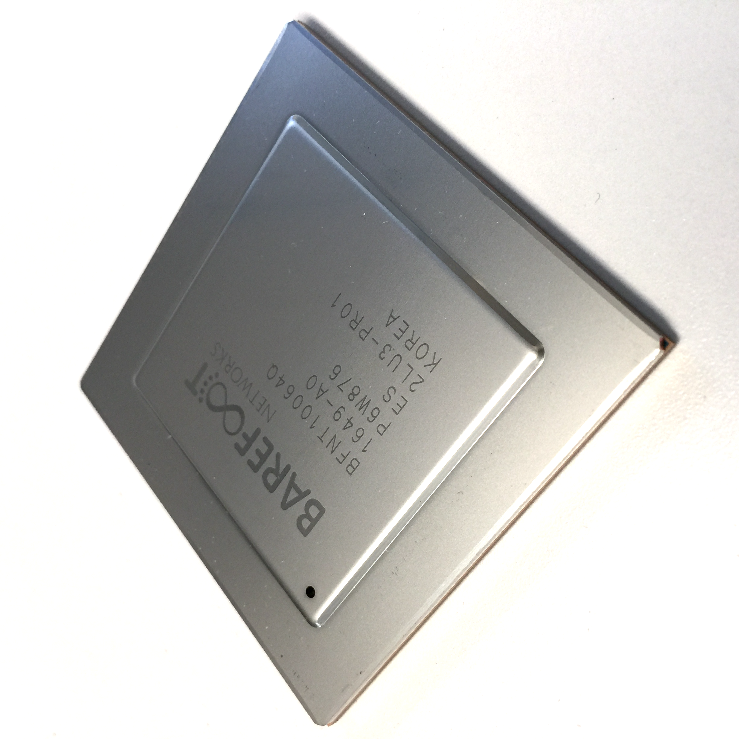
Network systems are starting to be programmed “top-down”
“This is precisely how you must process packets”
Switch OS
Driver
Programmable Switch

Slide 24
Why are programmable forwarding planes happening now?

Slide 25
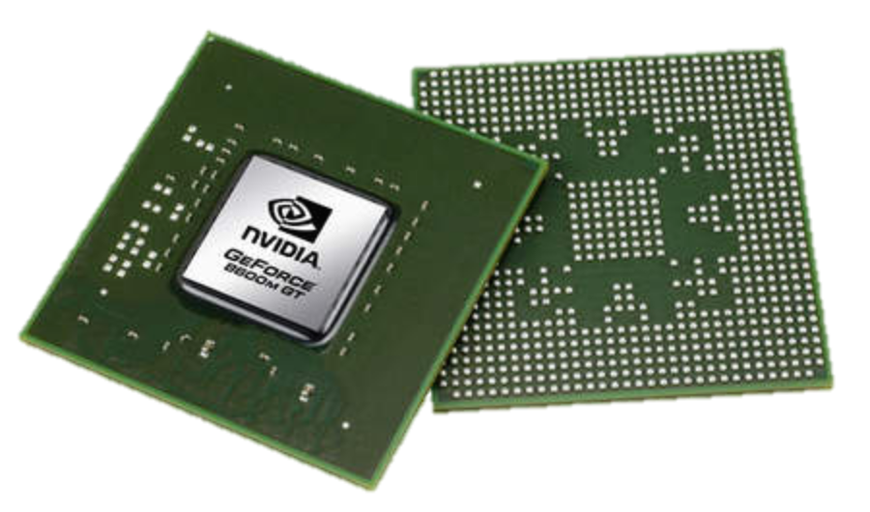
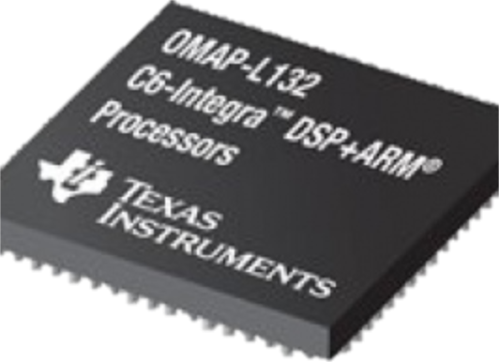
Domain Specific Processors
Signal
Processing
Machine
Learning
Computers
Graphics
Networking
Java
OpenCL
Matlab
TensorFlow
>>>
Language
Compiler
Compiler
Compiler
Compiler
Compiler
?
?
CPU
GPU
DSP
TPU

Slide 26
Domain Specific Processors
Signal
Processing
Machine
Learning
Computers
Graphics
Networking
Java
OpenCL
Matlab
TensorFlow
>>>
P4
Compiler
Compiler
Compiler
Compiler
Compiler
?
CPU
GPU
DSP
TPU
PISA

Slide 27
PISA: Protocol Independent Switch Architecture
Match+Action
Stage
Memory
ALU
Programmable
Parser
Programmable Match-Action Pipeline

Slide 28
PISA: Protocol Independent Switch Architecture

Slide 29
Example P4 Program
Parser Program
Header and Data Declarations
Tables and Control Flow
parser parse_ethernet {
extract(ethernet);
return switch(ethernet.ethertype) {
0x8100 : parse_vlan_tag;
0x0800 : parse_ipv4;
0x8847 : parse_mpls;
default: ingress;
}
header_type ethernet_t { … }
header_type l2_metadata_t { … }
header ethernet_t ethernet;
header vlan_tag_t vlan_tag[2];
metadata l2_metadata_t l2_meta;
table port_table { … }
control ingress {
apply(port_table);
if (l2_meta.vlan_tags == 0) {
process_assign_vlan();
}
}
Memory
ALU
Programmable
Parser
Programmable Match-Action Pipeline

Slide 30
P4 PISA chips starting to emerge
(2016)
Programmed using P4
Same power, performance & cost as fixed-function switches
Programs always run at line-rate
Several P4-programmable devices will emerge in next 2-3 years.
My prediction: Within 5 years, all switches will be programmable.
Notes:
Actual END POINT of talk

Slide 31
How programmability is being used
Reducing complexity
1

Slide 32
Reducing complexity
switch.p4
Switch OS
Driver
IPv4 and IPv6 routing
- Unicast Routing
- Routed Ports & SVI
- VRF
- Unicast RPF
- Strict and Loose
- Multicast
- PIM-SM/DM & PIM-Bidir
Ethernet switching
- VLAN Flooding
- MAC Learning & Aging
- STP state
- VLAN Translation
Load balancing
- LAG
- ECMP & WCMP
- Resilient Hashing
- Flowlet Switching
Fast Failover
– LAG & ECMP
Tunneling
- IPv4 and IPv6 Routing & Switching
- IP-in-IP (6in4, 4in4)
- VXLAN, NVGRE, GENEVE & GRE
- Segment Routing, ILA
MPLS
- LER and LSR
- IPv4/v6 routing (L3VPN)
- L2 switching (EoMPLS, VPLS)
- MPLS over UDP/GRE
ACL
- MAC ACL, IPv4/v6 ACL, RACL
- QoS ACL, System ACL, PBR
- Port Range lookups in ACLs
QOS
- QoS Classification & marking
- Drop profiles/WRED
- RoCE v2 & FCoE
- CoPP (Control plane policing)
NAT and L4 Load Balancing
Security Features
- Storm Control, IP Source Guard
Monitoring & Telemetry
Ingress Mirroring and Egress Mirroring
Negative Mirroring
Sflow
INT
Counters
Route Table Entry Counters
VLAN/Bridge Domain Counters
Port/Interface Counters
Protocol Offload
- BFD, OAM
Multi-chip Fabric Support
- Forwarding, QOS
Compiler
Programmable Switch

Slide 33
Reducing complexity
My switch.p4
Switch OS
Driver
Compiler
Programmable Switch

Slide 34
How programmability is being used
Adding new features
2

Slide 35
Adding features: Some examples so far
New encapsulations and tunnels
New ways to tag packets for special treatment
New approaches to routing: e.g. source routing in MSDCs
New approaches to congestion control
New ways to process packets: e.g. processing ticker-symbols

Slide 36
Example new applications using P4
Example #1: Layer-4 Load Balancer

Slide 37
Today: Hardware Layer 4 Load-balancing
Clients
Hardware Load Balancers
>$200+k each
Application Servers

Slide 38
Today: Software Layer 4 Load-balancing
Clients
Software Load Balancers
Application Servers

Slide 39
P4 Example: Layer 4 Load-balancing
P4 Program
Clients
Software Load Balancers
Application Servers

Slide 40
Example new applications using P4
Example 1: Layer-4 Load Balancer
  Replace 200 servers with one switch chip
  Operates at 6.5Tb/s
  All packets load-balanced in < 1μs
  Up to 10 million http flows
Publication
SilkRoad: Making Stateful Layer-4 Load Balancing Fast
and Cheap Using Switching ASICs.
Rui Miao et al. ACM Sigcomm 2017

Slide 41
Example new applications using P4
Example #2: Fast Firewall and Audit Trail
  Add over 1M new firewall entries per second
  Create audit record for every new flow and firewall entry
  Firewall now inline, at 6.5Tb/s and <1μs

Slide 42
Other P4 Applications
World’s fastest key-value store cache
World’s fastest DNS cache (to prevent DDoS)
World’s fastest storage network cache
World’s fastest consensus protocol for distributed applications
<Your beautiful new idea here!>

Slide 43
How programmability is being used
Network telemetry
3

Slide 44
“Which path did my packet take?”
“I visited Switch 1 @780ns,
Switch 9 @1.3µs, Switch 12 @2.4µs”
1
# | Rule
1
2
3
…
75 | 192.168.0/24
…
“In Switch 1, I followed rules 75 and 250. In Switch 9, I followed rules 3 and 80. ”
2
“Which rules did my packet follow?”

Slide 45
3
“How long did my packet queue at each switch?”
“Delay: 100ns, 200ns, 19740ns”
Queue
4
“Who did my packet share the queue with?”
Time

Slide 46
3
“How long did my packet queue at each switch?”
“Delay: 100ns, 200ns, 19740ns”
Aggressor flow!
Queue
4
“Who did my packet share the queue with?”
Time

Slide 47

We’d like the network to answer these questions
1
“Which path did my packet take?”
“Which rules did my packet follow?”
“How long did it queue at each switch?”
“Who did it share the queues with?”
2
3
4
With P4+PISA we can answer all four questions for the first time. At full line rate. Without generating additional packets.

Slide 48
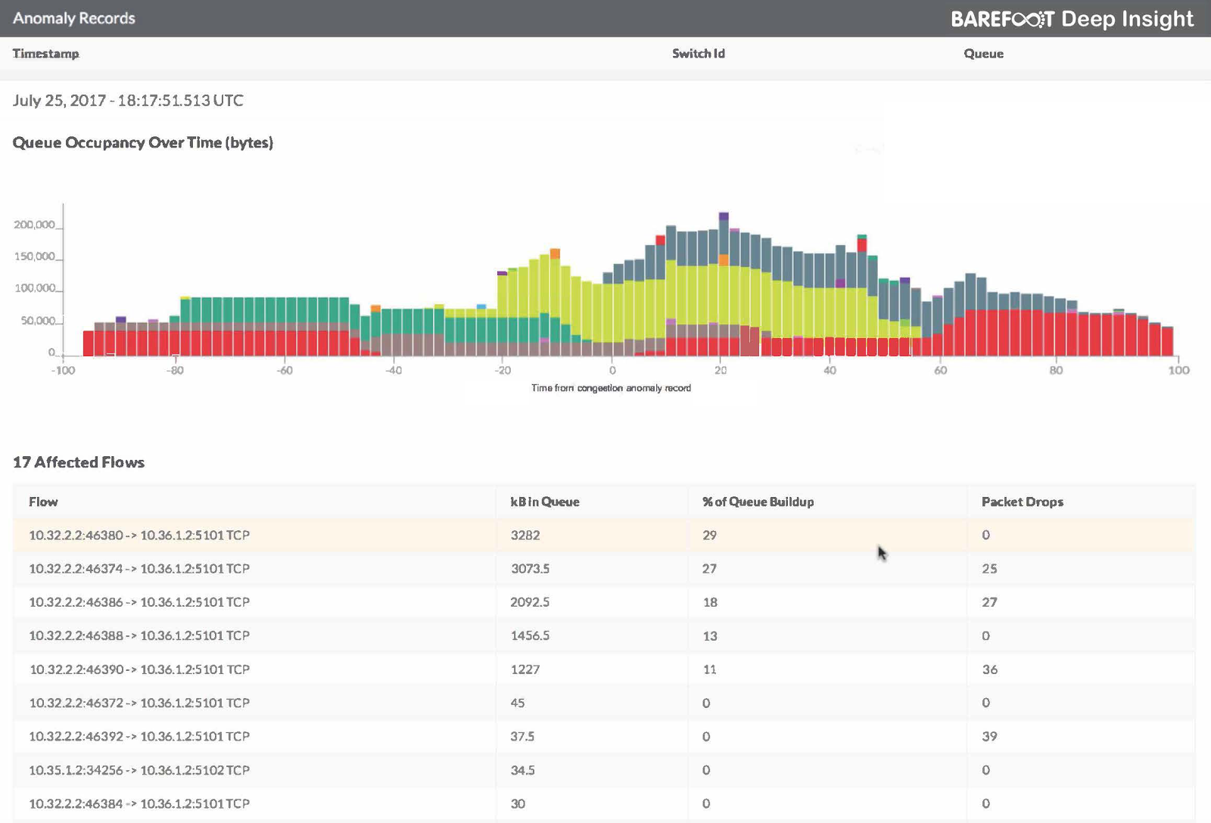
Viewing Microbursts (to the nanosecond)

Slide 49
How programmability is being used
Reducing complexity
Adding new features
Network telemetry
1
2
3

Slide 50
In summary…
SDN is about who is in control!
Part 1: Network owners decided how their networks are controlled.
Part 2: Next, they will decide how packets are processed.
Chip technology: From now on, programmable forwarding will have the same power, performance and cost as fixed function.
New ideas: Beautiful new ideas are now owned by the programmer, not the chip designer.

Slide 51
Thank you!
Visit www.p4.org for more information

